Slide 1
Contabilizamos
LO QUE VALORAMOS

Slide 2
BLANCO
DEL
MINISTERIO DE
MAYORDOMÍA CRISTIANA?
CUÁL ES EL
Notes:
The answer to those crucial questions will depend on what we understand as the department’s VISION and MISSION.

Slide 3
LO QUE VALORAMOS
¿QUÉ ES LO QUE MÁS VALORAMOS COMO RESULTADO DE NUESTRO TRABAJO?
Notes:
The answer to those crucial questions will depend on what we understand as the department’s VISION and MISSION.

Slide 4
¿POR QUÉ ES IMPORTANTE TENER UNA VISIÓN?
Ayuda a visualizar los resultados deseados.
Es crucial para establecer una estrategia.
Proporciona objetivos mensurables.
Notes:
It is told that someone asked Michelangelo about what he was carving out of a huge granite block. “A horse,” he answered. “But how can you carve a horse out of a block of granite!” that person answered in amazement. “It’s easy”, said Michelangelo. “My task is just to remove what is not the horse.” Interestingly, he could visualize a horse inside that granite block, and that vision allowed him to remove everything that wouldn’t pertain to it. Having a vision was crucial to molding his work strategy and shaping the outcome.

Slide 5
¿CUÁL DEBE SER LA VISIÓN DEL MINISTERIO DE MAYORDOMÍA CRISTIANA?
Notes:
It is also extremely important for us to have a clear vision of what we expect as the outcome of our work in the Stewardship Department. Should it be to have the church’s safes full of money, or to lead people to “fear God and give glory to Him, for the hour of His judgment has come” (Revelation 14:7)? Should pastors and spiritual leaders become just materialistic fundraisers or spiritual soul-seekers in Christ’s behalf? The answer to those questions will determine the strategy that we will adopt.

Slide 6
LA VISIÓN DEBERÍA SER...
¿La caja de la iglesia está llena de dinero?
¿Pastores y líderes espirituales convertidos en recaudadores de fondos?

Slide 7
O LA VISIÓN DEBERÍA SER...
¿Miembros de la Iglesia temendo a "Dios... porque..." (Ap 14:7)?
¿Líderes que trabajan en nombre de Cristo, preocupados por la salvación de las personas?

Slide 8
Una visión adecuada de la Mayordomía Cristiana sólo puede establecerse una vez que se ha desarrollado una comprensión de lo que es Mayordomía Cristiana.
Notes:
It is also extremely important for us to have a clear vision of what we expect as the outcome of our work in the Stewardship Department. Should it be to have the church’s safes full of money, or to lead people to “fear God and give glory to Him, for the hour of His judgment has come” (Revelation 14:7)? Should pastors and spiritual leaders become just materialistic fundraisers or spiritual soul-seekers in Christ’s behalf? The answer to those questions will determine the strategy that we will adopt.

Slide 9
MAYORDOMÍA: DEFINICIÓN (AMPLIA)
”Mayordomía es la administración
de lo que
pertenece a otro.” Mel Rees
Notes:
An appropriate vision for the Stewardship Department will only develop after an understanding of what Stewardship is. An interesting definition says that “Stewardship is the management of that which belongs to another,” i.e., which belongs to God—the Owner of all things (Psalm 24:1-3; 1 Cor. 10:26).
Rees, Mel, Basic Stewardship Manual, General Conference Church Ministries, 1990, page 7.

Slide 10
MAYORDOMÍA CRISTIANA: DEFINICIÓN
“Mayordomía es la tarea asignada por Dios al hombre para que le reconozca como Creador, Redentor y Señor, y para que administre sus asuntos en el planeta Tierra, guiado por el principio de ‘Dios primero’."

Slide 11
BUEN MAYORDOMO...
"Una persona que reconoce la realidad y la pena de su pecado individual (Rom. 3:23-24; 6:33), acepta la muerte de Jesús en su favor (Rom. 6:33; Juan 3:16), y acepta el señorío de Jesús (Lucas 2:11), negando el "yo" (Gal. 2:20; Lucas 9:23-25). Esta persona vive en íntima relación con Él (Juan 15:1-5), confiando en Él (Hebreos 11:6); mediante la morada del Espíritu se convierte en una nueva criatura (Ezequiel 36:26; 2 Corintios 5:17), y sirve a Dios como Su representante, administrando Sus cosas en el Planeta Tierra (1 Corintios 3:9; 2 Corintios 5:20) guiado por el principio del ‘Primer Dios’."

Slide 12
¿CÓMO ENCONTRAR LA FELICIDAD Y EL SENTIDO?
Sólo administrando la propia vida y el entorno social y material de acuerdo con las especificaciones divinas.
Pero, ¿cómo administrar tu vida y tu entorno?

Slide 13
NUESTRO MENSAJE PARA LOS ÚLTIMOS DÍAS:
"... para toda nación, lengua, tribu y pueblo". Ap 14:6
"... Temed a Dios y dadle gloria, porque ha llegado la hora de su juicio".
Ap 14:7
Mark Finley: "Temer a Dios es ponerlo en primer lugar en nuestras vidas". Los Tres Mensajes Angélicos (LES, 18 de abril de 2023), página 33.

Slide 14
EL PRINCIPIO CLAVE DE JESÚS
"Buscad primero el reino de Dios y su justicia, y todas estas cosas os serán añadidas "Mateo 6:33
Notes:
Jesus stated a key principle of management (or stewardship) that, if practiced, will bring everything else into the right perspective. He promised that if we “seek first the kingdom of God and His righteousness… all these things shall be added to you.” Matthew 6:33 (NJKV). True success in all areas of life can only be obtained by putting God first.

Slide 15
LO QUE HA HECHO SATANAS...
Su "objetivo... [es] llevar a los hombres a anteponerse a sí mismos [a poner el yo primero]...". CS, 24.
Este tipo de mentalidad, "llena el mundo de miseria y contiendas, enfrentando a los seres humanos entre sí." CS, 24.
Notes:
It is because Satan knows this, that his “aim has been to lead men to self first...”, instead of God first. And this kind of mindset “has filled the world with misery and strife…” becoming the main reason for environmental and economic problems, marriage failures, and the breakdown of any other social relations.
White, Ellen G., Counsels on Stewardship, page 24.

Slide 16
LA ESENCIA DE LA DEPRAVACIÓN
"El egoísmo es la esencia de la depravación, y porque los seres humanos se han sometido a su poder, . . . Las naciones, las familias y los individuos están llenos del deseo de hacer del yo un centro." CS, 24

Slide 17
¿CÓMO OPONERSE A LA OBRA DE SATANÁS?
Notes:
If Satan aims “to lead men to self first,” filling “the world with misery and strife,” we are called to partner with God in counterfeiting Satan’s work.

Slide 18
VISIÓN: "PERSONAS PONIENDO A DIOS PRIMERO".

Slide 19
¿QUIÉN DEBE SER INVITADO?
¿Sólo los miembros de la Iglesia?
¿O "toda nación, tribu, lengua y pueblo" son los que están llamados a temer "a Dios y darle gloria" (Ap. 14:6, 7)?
Notes:
Not only church members are invited to put God first, but “every nation, tribe, tongue, and people” are called to “fear God and give glory to Him” (Revelation 14:6-7), recognizing Him while managing life and the spiritual, social, and material environments.

Slide 20
¿CÓMO PONER A DIOS EN PRIMER LUGAR?
¿Sólo en el ámbito de los valores? (Subjetivo)
¿O también debe primar en nuestras prácticas y programa diario? (Objetivo)
Notes:
And God should be put first not only in the realm of values but also be given primacy in our daily schedule and practices. You will find in the “I Promise” Commitment Card seven crucial points in which we are invited to trust God and partner with Him in His final mission.
Find the “I Promise” God First Commitment Card here: https://stewardship.adventist.org/commitment-card-promise

Slide 21
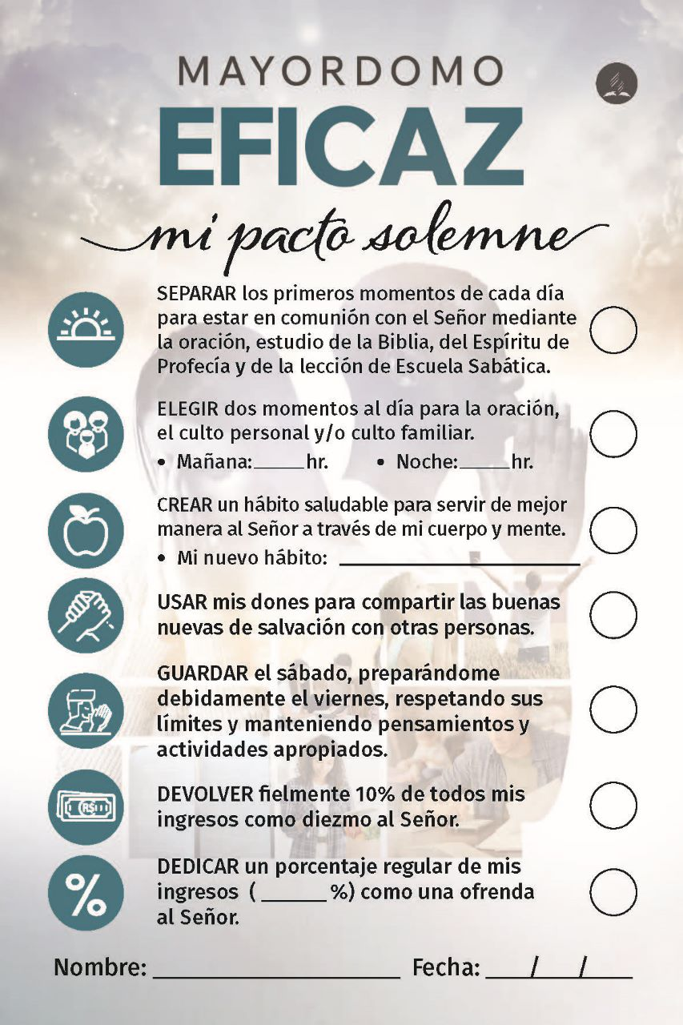
“MI PACTO”
TARJETA DE COMPROMISO
https://downloads.adventistas.org/pt/departamento/mordomia-crista/
Notes:
Find the “I Promise” God First Commitment Card here: https://stewardship.adventist.org/commitment-card-promise

Slide 22
ESTRATEGIA
Principio
Compromiso
(Mat 6:33)
Notes:
And because this vision, “People putting God first,” is broader than the scope of a single department, the Adventist Church has created many ministries or departments (like Education, Sabbath School & Personal Ministries, Health, Family Ministries, Women Ministries, just to mention some), all doing their part in nurturing people to embrace the principles of stewardship (or management) at large.

Slide 23
¿CUÁL ES LA CONTRIBUCIÓN ESPECÍFICA DEL MINISTERIO DE MAYORDOMÍA CRISTIANA?
Notes:
Our mission statement has to do with the specific contribution of the Stewardship Ministries department to this broad “God first” vision, which should also be carried out by all other church departments. Since its inception, the Stewardship Department's mandate has been to focus, but not exclusively, on “inviting people to trust God as Owner and Provider, and to partner in His final mission through regular and systematic giving”.

Slide 24
MISIÓN:
"INVITAR A LA GENTE A CONFIAR EN DIOS COMO DUEÑO Y PROVEEDOR, Y A ASOCIARSE CON ÉL EN SU MISIÓN FINAL A TRAVÉS DE LA DONACIÓN REGULAR Y SISTEMÁTICA".
Notes:
Our mission statement has to do with the specific contribution of the Stewardship Ministries department to this broad “God first” vision, which should also be carried out by all other church departments. Since its inception, the Stewardship Department's mandate has been to focus, but not exclusively, on “inviting people to trust God as Owner and Provider, and to partner in His final mission through regular and systematic giving”.
There are some key elements in this mission statement. First, the Stewardship Department is not in the business of inviting people to “give” but to trust God, as Owner and Provider.
A second point to be highlighted is about partnering with God and acting as His agents on the Earth. This partnership, which is proposed by Him, embraces privileges and responsibilities, and also includes our finances (e.g. Proverbs 3:9-10; Malachi 3:10; 1 Corinthians 3:9; 16:2). In line with those Bible verses, Ellen G. White says for instance that “the Lord made a special covenant with men, that if they would regularly set apart the portion designated for the advancement of Christ’s kingdom, the Lord would bless them abundantly, so that there would not be room to receive…” She also adds that “if men will become channels through which heaven’s blessing can flow to others, the Lord will keep the channel supplied.”
The final emphasis in the mission statement is that people are invited to exercise trust in God primarily through regular and systematic giving. White, Ellen G., Counsels on Stewardship, page 77.
Idem, page 36.

Slide 25
¿POR QUÉ ESTE ÉNFASIS EN LA OFRENDA
REGULAR Y SISTEMÁTICA?
Notes:
Why have such an emphasis on regular and systematic giving? Why not simply suggest that people give always “after your heart”?

Slide 26
¿POR QUÉ NO DAR SEGÚN EL CORAZÓN?

Slide 27
EL CORAZÓN HUMANO...
”Engañoso es el corazón más que todas las cosas, y perverso; ¿quién lo conocerá?" (Jer. 17:9).
Notes:
Even though the heart may sometimes be rightly susceptible to being impressed by God, that is not generally the case. Those who trust too much in their hearts, always allowing their impressions or feelings to command their actions, frequently ignore that the heart is naturally selfish and “deceitful above all things” (Jeremiah 17:9).

Slide 28
NO PUEDES CONFIAR EN LOS IMPULSOS HUMANOS...
"... El egoísmo es el más fuerte y generalizado de los impulsos humanos; la lucha del alma entre la simpatía y la codicia es una lucha desigual... Por eso, en nuestro trabajo y en nuestros dones a la causa de Dios, no es seguro dejarse dominar por el sentimiento o el impulso." CS, 25
Notes:
Ellen G. White says that because “selfishness is the strongest and most general of human impulses… in our labors and gifts for God’s cause it is unsafe to be controlled by feeling or impulse.”
Ibidem, page 25.
Therefore, we are encouraged by God to “act from fixed principle, following the Saviour’s example of self-denial and self-sacrifice,” instead of acting purely upon feelings and impressions. At the same time, we need to pray for a change of heart, which is promoted by the indwelling of the Holy Spirit (Ezekiel 36:26-27)—a heart more inclined to do what is right, to “act from fixed principle.” Ibidem, page 25.

Slide 29
¿CÓMO DEBEMOS ACTUAR?
"... Los cristianos deben actuar guiados por principios fijos, siguiendo el ejemplo de abnegación y sacrificio del Salvador". CS, 25
Notes:
Therefore, we are encouraged by God to “act from fixed principle, following the Saviour’s example of self-denial and self-sacrifice,” instead of acting purely upon feelings and impressions. At the same time, we need to pray for a change of heart, which is promoted by the indwelling of the Holy Spirit (Ezekiel 36:26-27)—a heart more inclined to do what is right, to “act from fixed principle.” Then, “the cause of benevolence would no longer be dependent on the uncertain gifts of impulse, and vary according to the changing feelings of men.”
Ibidem, page 25.
Ibidem, pages 199, 200.

Slide 30
¿QUÉ OCURRIRÍA EN CONSECUENCIA?
"... ¿No dependería la causa de la beneficencia de la incertidumbre de los dones que resultan del impulso y varían según los sentimientos cambiantes del hombre...". CS, 199, 200.
Notes:
Then, “the cause of benevolence would no longer be dependent on the uncertain gifts of impulse, and vary according to the changing feelings of men.”
Ibidem, pages 199, 200.

Slide 31
PORQUE LAS POSESIONES SON PORTADORAS DE AFECTO...
Dios nos anima a poner nuestros recursos, regular y sistemáticamente, donde queremos que esté nuestro corazón (Mt 6:21).
Notes:
Because “possessions are carriers of affections”, we are encouraged by God to regularly and systematically place our resources where we want our hearts to be (see Matthew 6:21). Bomfim, Marcos F. (2020). Nurture and Heart Retention: a reliable predictor helps to prevent dropout; General Conference of the Seventh-day Adventists Nurture and Retention Committee (Ed.). Discipling, Nurturing, and Reclaiming: Nurture and Retention Summit (page 90). Silver Spring, MD: Review and Herald Publishing Association.

Slide 32
¿CUÁL DEBE SER LA
REGULARIDAD Y EL SISTEMA?
Regularidad: Basada en los ingresos (Prov. 3:9).
Sistema: Proporcional a los ingresos (Dt 16:17; 1 Co 16:2; 2 Co 8:12).
Notes:
And what should be the regularity and the system by which we give tithe and regular offerings? The regularity is determined by the receipt of an income or increase, and our primary giving system, even for offerings, is proportioned to the income, or percent based (see e.g. Deuteronomy 16:17, 1 Corinthians 16:2, and 2 Corinthians 8:12).

Slide 33
ESTA ES LA OFRENDA CONOCIDA COMO
¡"PACTO"!
https://stewardship.adventist.org/promise-offerings
Notes:
Why have such an emphasis on regular and systematic giving? Why not simply suggest that people give always “after your heart”?

Slide 34
CAMBIO DE PARADIGMA
Dios se convierte en el centro del dar.
“Pactuantes" ya no están dominados "por los sentimientos o el impulso". CS, 25

Slide 35
CAMBIO DE PARADIGMA
Los “Pactuantes" ya no dan como donantes, filántropos, para ayudar, patrocinar o apoyar algo o a alguien.
Ya no dan sólo cuando sienten que deben hacerlo.

Slide 36
CAMBIO DE PARADIGMA
Los “Pactuantes” ya no anhelan el reconocimiento humano.
Los “Pactuantes” dan como respuesta a las bendiciones de Dios, no a la espera de ellas.

Slide 37
¿CÓMO SABER...?
¿Si estamos logrando invitar a la gente a confiar en Dios como Dueño y Proveedor, y a asociarse con Él en su misión final a través de la donación regular y sistemática?
Notes:
How do we know if we are succeeding in inviting people to trust God and partner in His final mission through regular and systematic giving? How do we assess our progress? Should we consider the increase in tithe and offering income in a congregation or field as an indicator of increased trust in God on the part of its members? Not at all.

Slide 38
¿CÓMO SABER...?
¿Puede considerarse el aumento de diezmos y ofrendas un indicador fiable de que crece la confianza en Dios por parte de los miembros de la iglesia?
¿Cuáles deberían ser entonces nuestros blancos mensurables?
Notes:
How do we know if we are succeeding in inviting people to trust God and partner in His final mission through regular and systematic giving? How do we assess our progress? Should we consider the increase in tithe and offering income in a congregation or field as an indicator of increased trust in God on the part of its members? Not at all.

Slide 39
¿QUÉ COSAS DEBEMOS CONTAR?
"Contamos lo que valoramos y valoramos lo que contamos". Desconocido.
Notes:
Tithe and offering income growth is not necessarily an indication of spiritual growth in a congregation. It may be just a reflection of the blessing that one single person has received in that congregation or field. And as our mission statement is focused on spiritual growth, instead of financial growth, we are supposed to count not money, but people’s participation, i.e., the proportion of those engaged in regular and systematic giving. As the saying goes, “we count what we value, and we value what we count”.

Slide 40
BLANCO:
"AL PRINCIPIO DE CADA AÑO, UN 2% ADICIONAL DE LOS MIEMBROS ESTÁ DIEZMANDO Y DEVOLVIENDO LAS OFRENDAS REGULARES Y SISTEMÁTICAS (PACTO)".

Slide 41
LAS PREGUNTAS MÁS IMPORTANTES
¿Qué proporción del total de miembros da actualmente diezmos y ofrendas regulares y sistemáticas?
¿Esta proporción aumenta o disminuye cada año?

Slide 42
OTRAS PREGUNTAS IMPORTANTES
¿Qué proporción del salario, em promedio, los miembros de este territorio/iglesia devuelven de "Pacto"?
¿Esta proporción aumenta o disminuye?
Notes:
Those questions must be thoroughly answered, data must be accessed and plans accordingly devised, otherwise, the vision, “people putting God first,” will never be accomplished.
But how can we assess this information? The General Conference has made available the ACMS (Adventist Church Management System), which is able to synchronize and cross treasury and secretary information, revealing the current percentage of incognito members of a given congregation or field that are Promisors, or regular and systematic givers. If your field is already using that system, you can assess that information in seconds.
By primarily assessing people’s participation, stewardship leaders reveal that they want more than simply to promote an increase in the church’s financial income, as important as it may be for the accomplishment of Christ’s Great Commission. They want to see more and more people knowing God more intimately, trusting Him, learning how to live by faith, and finally populating heaven after Jesus’ second coming. Even so, come, Lord Jesus!
In 2022 the ACMS was already in use in 10 divisions and 89 unions.

Slide 43
¿HAS OÍDO HABLAR DE
ACMS?
ACMS = Adventist Church Management System
En 2022, el ACMS ya era utilizado por 10 divisiones y 89 uniones.
Notes:
And God should be put first not only in the realm of values but also be given primacy in our daily schedule and practices. You will find in the “I Promise” Commitment Card seven crucial points in which we are invited to trust God and partner with Him in His final mission.
Find the “I Promise” God First Commitment Card here: https://stewardship.adventist.org/commitment-card-promise

Slide 44
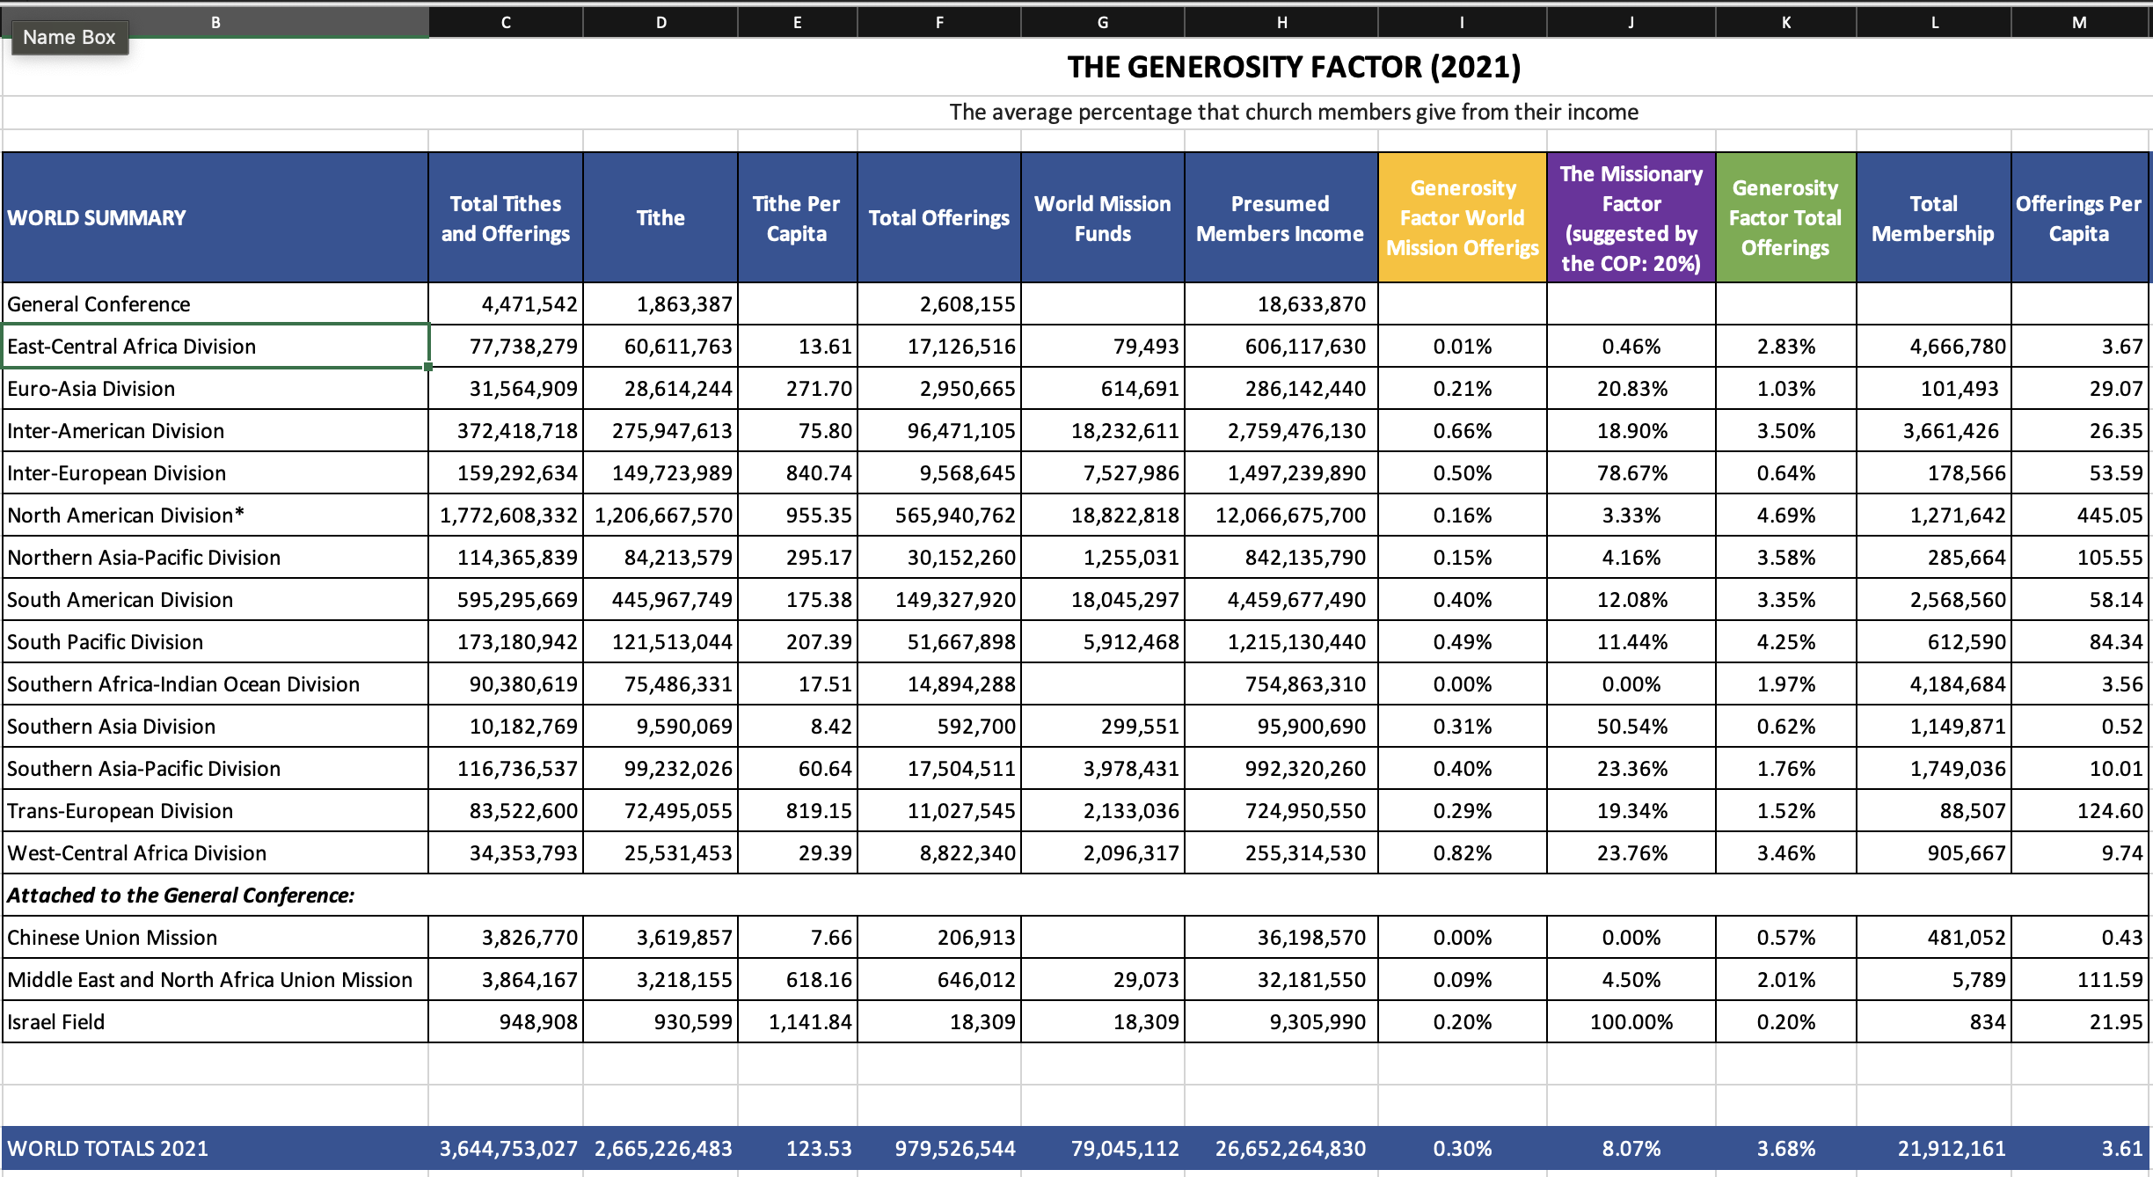
FACTOR DE GENEROSIDAD - 2021
Notes:
Una tabla con datos de 2021, basado en el Informe Estadístico Annual 2022 (2022 Annual Statistical Report), de la Asociación General.

Slide 45
Ranking | Division/Field | 2021 Generosity Factor (Mission Offerings)
1 | West Central Africa Division | 0.82%
2 | Inter-American Division | 0.66%
3 | Inter-European Division | 0.50%
4 | South Pacific Division | 0.49%
5 | South American Division | 0.40%
6 | Southern Asia-Pacific Division | 0.40%
7 | Southern Asia Division | 0.31%
8 | Trans-European Division | 0.29%
9 | Euro-Asia Division | 0.21%
10 | Israel Field | 0.20%
11 | North American Division | 0.16%
12 | Northern Asia-Pacific Division | 0.15%
13 | Middle East and North Africa Union Mission | 0.09%
14 | Southern Africa-Indian Ocean Division | 0.00%
15 | Chinese Union Mission | 0.00%
16 | East-Central Africa Division | 0.01%
2020 World Totals | General Conference | 0.28%
2021 World Totals | General Conference | 0.30%
FACTOR DE GENEROSIDAD – 2021 (Ofrendas misioneras)
Notes:
En esta table, cual es “la proporción del ingreso que en promedio miembros de estos territorios dan para las misiones estranjeras?

Slide 46
Ranking | Division/Field | Generosity Factor (Total Offerings)
1 | North American Division | 4.69%
2 | South Pacific Division | 4.25%
3 | Northern Asia-Pacific Division | 3.58%
4 | Inter-American Division | 3.50%
5 | West-Central Africa Division | 3.46%
6 | South American Division | 3.35%
7 | East-Central Africa Division | 2.83%
8 | Middle East and North Africa Union Mission (MENAUM) | 2.01%
9 | Southern Africa-Indian Ocean Division | 1.97%
10 | Southern Asia-Pacific Division | 1.76%
11 | Trans-European Division | 1.52%
12 | Euro-Asia Division | 1.03%
13 | Inter-European Division | 0.64%
14 | Southern Asia Division | 0.62%
15 | Chinese Union Mission | 0.57%
16 | Israel Field | 0.20%
2020 World Totals | General Conference | 3.70%
2021 World Totals | General Conference | 3.68%
FACTOR DE GENEROSIDAD– 2021 (Ofertas totales)
Notes:
En esta tabla, cual es el percentage del ingreso que en promedio miembros de este territorio entregan como “Pacto” (ofrenda regular y sistematica).

Slide 47
Ranking | Division/Field | 2021 Missionary Factor (Mission Offerings)
1 | Israel Field | 100%
2 | Inter-European Division | 78.67%
3 | Southern Asia Division | 50.54%
4 | West-Central Africa Division | 23.76%
5 | Southern Asia-Pacific Division | 23.36%
6 | Euro-Asia Division | 20.83%
7 | Trans-European Division | 19.34%
8 | Inter-American Division | 18.90%
9 | South American Division | 12.08%
10 | South Pacific Division | 11.44%
11 | Middle East and North Africa Union Mission | 4.50%
12 | Northern Asia-Pacific Division | 4.16%
13 | North American Division | 3.33%
14 | East-Central Africa Division | 0.46%
15 | Southern Africa-Indian Ocean Division | 0.00%
16 | Chinese Union Mission | 0.00%
2020 World Totals | General Conference | 0.28%
2021 World Totals | General Conference | 0.30%
FACTOR MISIONERO– 2021 (Ofertas totales)
Notes:
En esta tabla, cual es el porcentaje del total de ofrendas que estos territorios envían para los Campos misioneros.

Slide 48
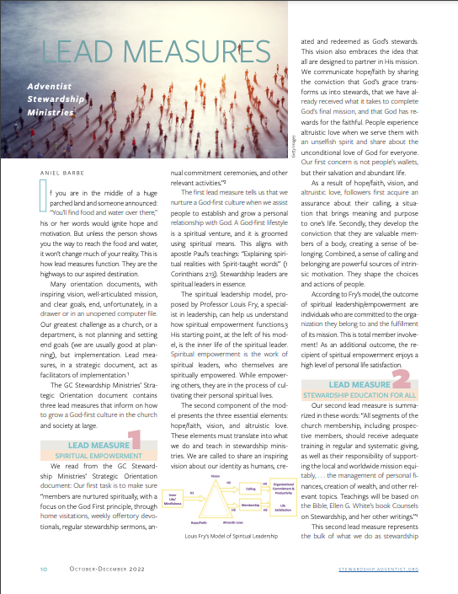
Próxima actividad: lee el artículo de Aniel Barbe sobre las tres "Medidas Guías Para los Ministerios Adventistas de Mayordomía".
Responde a la pregunta: ¿Cuáles son las tres medidas guías y qué recursos existen para motivar a las personas a poner a Dios Primero de forma regular y sistemática?
Lea el artículo aquí.
https://f000.backblazeb2.com/file/deptos/mayordomiacristiana/steward-dynamic/2022-4-Octubre-Diciembre.pdf
Notes:
And God should be put first not only in the realm of values but also be given primacy in our daily schedule and practices. You will find in the “I Promise” Commitment Card seven crucial points in which we are invited to trust God and partner with Him in His final mission.
Find the “I Promise” God First Commitment Card here: https://stewardship.adventist.org/commitment-card-promise

Slide 49
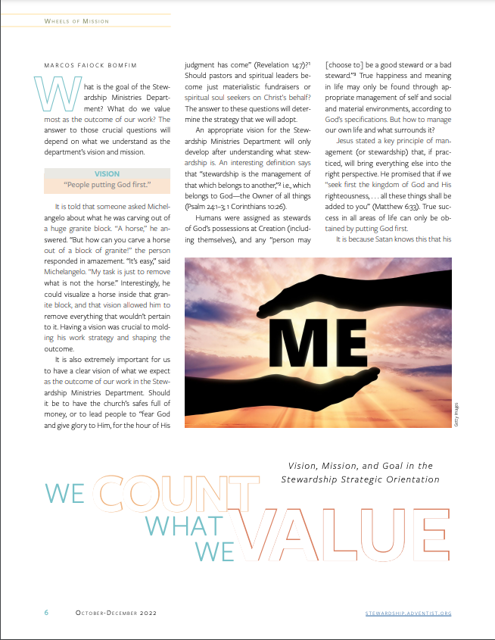
Lea aquí el artículo "Contamos lo que valoramos".
https://f000.backblazeb2.com/file/deptos/mayordomiacristiana/steward-dynamic/2022-4-Octubre-Diciembre.pdf
Notes:
And God should be put first not only in the realm of values but also be given primacy in our daily schedule and practices. You will find in the “I Promise” Commitment Card seven crucial points in which we are invited to trust God and partner with Him in His final mission.
Find the “I Promise” God First Commitment Card here: https://stewardship.adventist.org/commitment-card-promise

Slide 50
Vea el vídeo de esta presentación aquí:

